Slide 1
Survey on Query Suggestion
Jack Sun
Powered by SIGIR
Notes:
Hi, everyone, I have been working on the topic of query suggestion for a while. And today I will show some state-of-the-art ideas of this field. Today’s content is based on my recent survey.
I will present two papers within one hour, and both of them are from SIGIR in the most recent 3 years. BTW, SIGIR means Special Interest Group of Information Retrieval.

Slide 2
Content
Background
Paper I (from Google)
Paper II (from Microsoft)
Summary
Notes:
Here is the content of today’s presentation. Firstly, I will introduce the background of query suggestion, illustrating the importance and intuition of this problem.
And then, as I just stated, I will present two papers. Paper one is written by a guy under the help of Google, which is published in SIGIR 2010.
Paper II is from MSRA. It is published just not long ago in SIGIR 2012.
Besides: I will try to simplify the content of these papers and make sure that all of you guys can understand them. BTW, you can interrupt me whenever you get confused.
extract all the key ideas of them. As for the machine learning techniques, I want just omit the details because I think the most significant part is the extracted features or measurements, not the machine learning methods. To tell the truth, I’m also not an expert on that…

Slide 3
Background
Notes:
Now I will start to introduce the background of query suggestion.

Slide 4
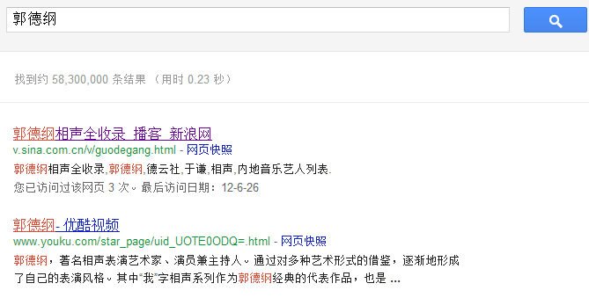
What Happens when We Search in SE?
Two Procedures:
User Parts: Compose a Query
SE Parts: Return Ranked List of Result
Notes:
Firstly, let’s see. What on earth happens when we search in a search engine? ^_^ Anybody can answer this question?
That’s right, a common procedure for a query is divided into two parts:
User is responsible for providing a query to search,
and search engine should return a ranked list of results to users.
Like the picture.

Slide 5
General Challenges
Two Challenges:
User’s Challenge: Think of GOOD Query
SE’s Challenge: Return Well-Ranked List for given Queries
Either Fails Search Fails
Notes:
Thus, generally speaking, we can conclude with 2 challenges.
[CLICK]
As a user, he or she has to come up with a query, which is specific enough for Search Engine to Understand. We can call it a GOOD Query.
As a qualified search engine, it should be able to return a MOST relevant and well-ranked list of results for a given query.
So you can see that, if either part fails, the search will probably fail.

Slide 6
Goal of Query Suggestion
Two Challenges:
User’s Challenge: Think of GOOD Query
Trying to help USERs to Compose a GOOD Query.
Notes:
So here comes the goal of query suggestion, it tries to kill users’ challenge, i.e. [CLICK] to help users to come up with a GOOD query.
That’s all for the background, next I will start to introduce the two papers.

Slide 7
Paper I
Generalized syntactic and semantic models of query reformulation
SIGIR ‘10
Notes:
First, let’s see the paper ONE. It is a paper from Google, published in SIGIR 2010.
The title is ------. The red phrases are the key point of this paper.

Slide 8
Whole Picture
AIM: String Similarity Combination of Semantic Association
Edit Distance
Generalized Edit Distance
Point-wise Mutual
Information (PMI)
Notes:
To begin with, let’s start take a look at the whole picture of this paper.
In order to suggest, this paper is trying to combine both syntactic and semantic meaning of queries.
Syntactic meaning is represented by “string similarity”, which is implements by edit distance.
[CLICK]
Semantic meaning is represented by semantic association, which is implement by point-wise mutual information, i.e. PMI.
[CLICK]
The combination is achieved through a generalized edit distance algorithm.
[CLICK]
Next, I will show them respectively.

Slide 9
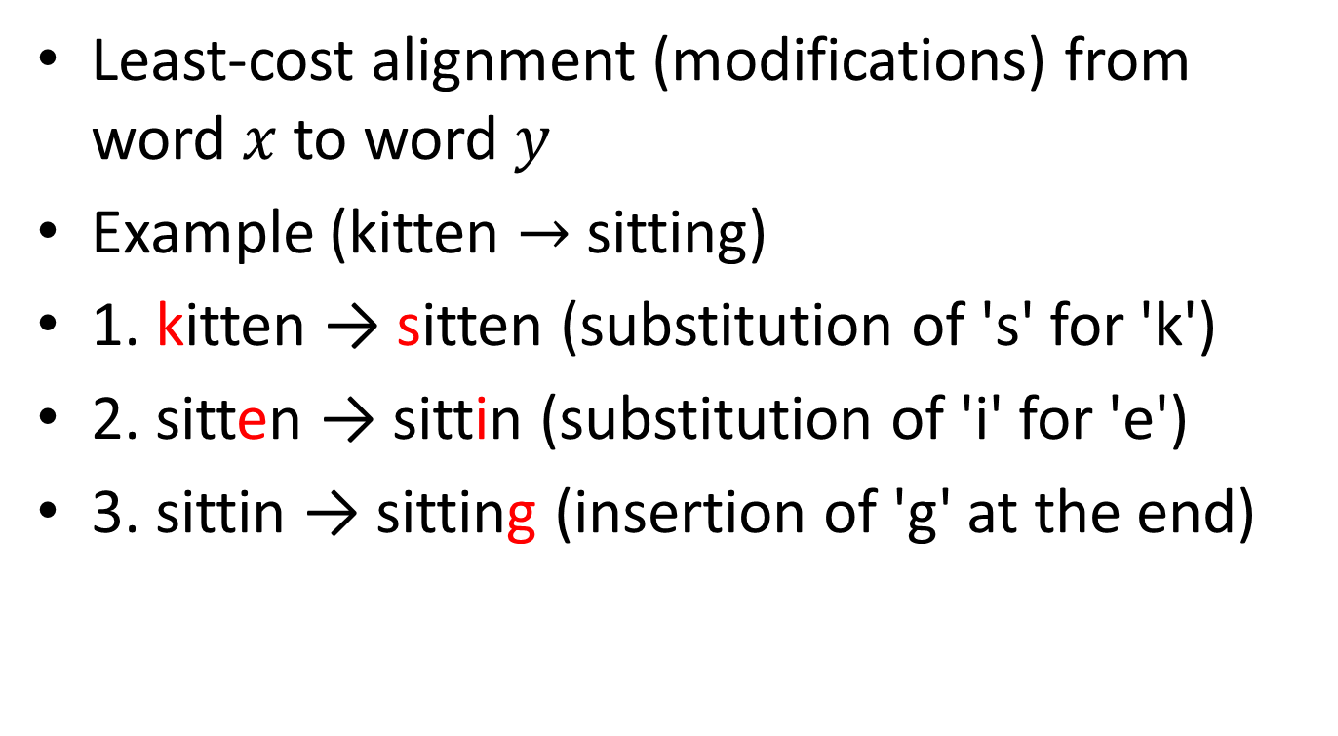
Edit Distance
Least-cost alignment (modifications) from word $x$ to word $y$
Example (kitten $→$ sitting)
1. kitten → sitten (substitution of 's' for 'k')
2. sitten → sittin (substitution of 'i' for 'e')
3. sittin → sitting (insertion of 'g' at the end)
Notes:
First is the edit distance, it is used to represent the least-cost alignment to change a word x into another word y.
Here is an simple example.

Slide 10
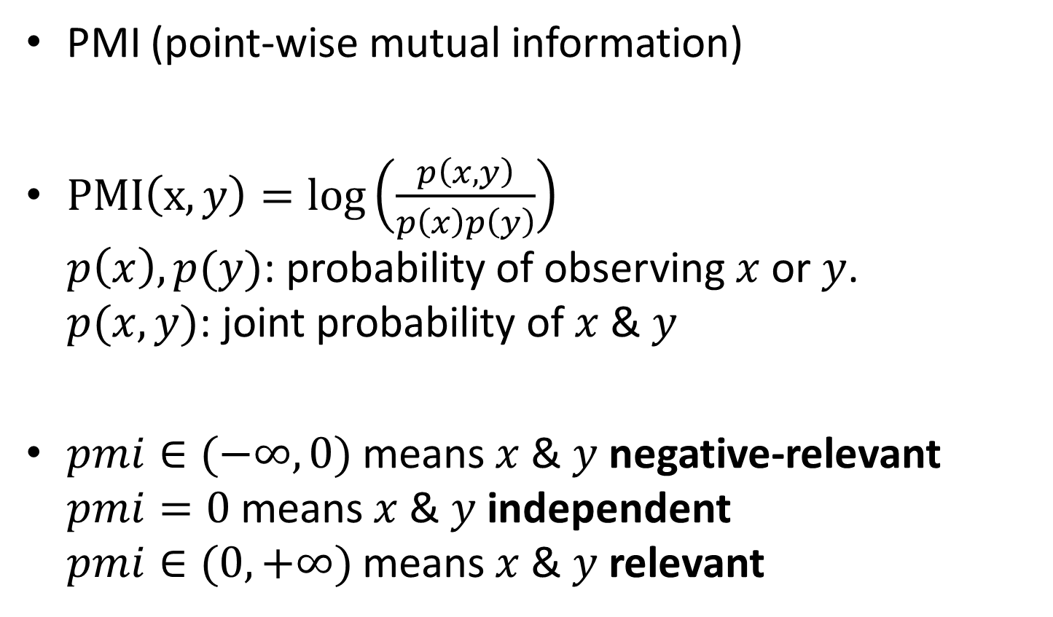
Semantic Measurement
PMI (point-wise mutual information)
$PMI\left(x, y\right)=log\left(\frac{p\left(x, y\right)}{p\left(x\right)p\left(y\right)}\right)$ $p\left(x\right),p(y)$: probability of observing $x$ or $y$. $p(x,y)$: joint probability of $x$ & $y$
$pmi∈(−∞,0)$ means $x$ & $y$ negative-relevant $pmi=0$ means $x$ & $y$ independent $pmi∈(0,+∞)$ means $x$ & $y$ relevant
Notes:
The semantic meaning is represented by PMI. PMI is defined like this. [CLICK]
$p\left(x\right),p(y)$: probability of observing $x$ or $y$.
$p(x,y)$, joint probability of $x$ & $y$, i.e. the probability of co-occurrence of x & y.
[CLICK] Here is the intuition of this measurement. 念一遍. Can you understand this? Explain pmi=0! Independent means $p(x,y)=p(x)p(y)$
[CLICK] as for we only care about the positive-relevant relationship.

Slide 11
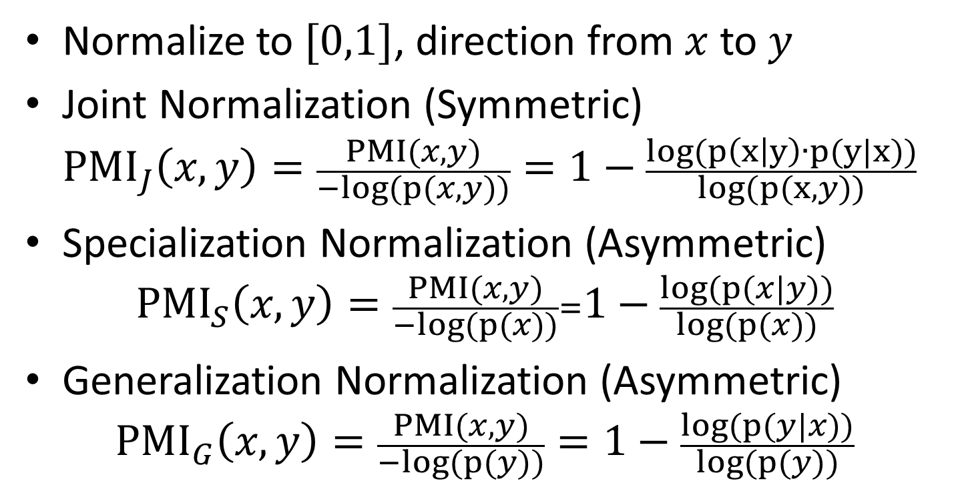
Normalization of PMI
Normalize to $[0,1]$, direction from $x$ to $y$
Joint Normalization (Symmetric) ${PMI}_{J}\left(x,y\right)=\frac{PMI(x,y)}{−log(p(x,y))}=1−\frac{log(p\left(x | y\right)∙p(y|x))}{log(p(x,y))}$
Specialization Normalization (Asymmetric) ${PMI}_{S}\left(x,y\right)=\frac{PMI(x,y)}{−log(p(x))}=1−\frac{log(p(x|y))}{log(p(x))}$
Generalization Normalization (Asymmetric) ${PMI}_{G}\left(x,y\right)=\frac{PMI(x,y)}{−log(p(y))}=1−\frac{log(p(y|x))}{log(p(y))}$
Notes:
$p$(x|y)$=1→y∈x→\{x is a concept and y is the according instance\}$
So it is a specialization from x to y.

Slide 12
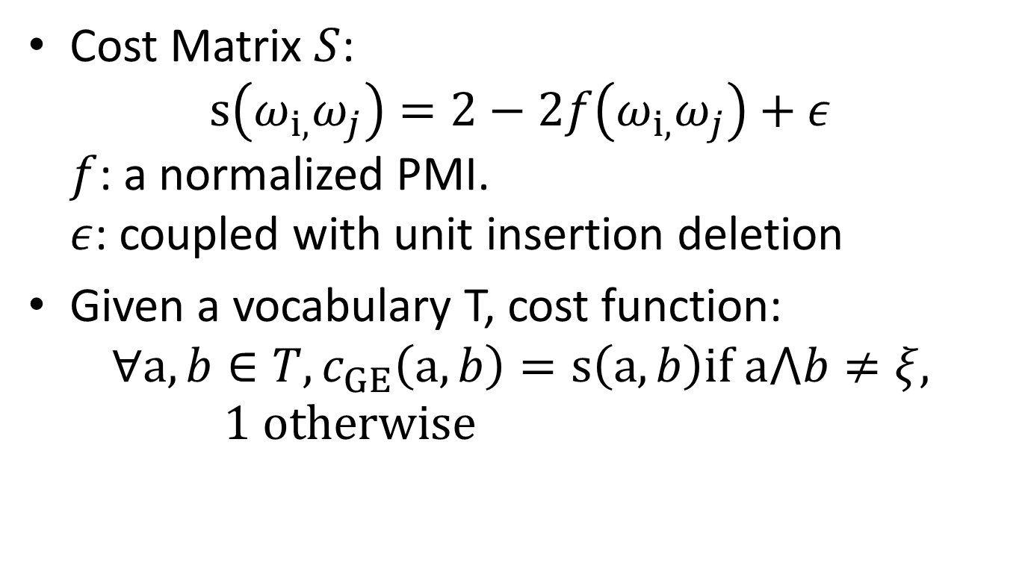
Combination
Cost Matrix $S$: $s\left(ω_{i,}ω_{j}\right)=2−2f\left(ω_{i,}ω_{j}\right)+ε$ $f$: a normalized PMI. $ε$: coupled with unit insertion deletion
Given a vocabulary T, cost function: $∀a,b∈T,c_{GE}\left(a,b\right)=s\left(a,b\right)if a⋀b≠ξ, 1 otherwise$
Notes:
$a⋀b$ means the co-occurrence of a and b.

Slide 13
Paper II
Adaptive Query Suggestion for Difficult Queries

Slide 14
Whole Picture
AIM:
Not only RELEVANT but USEFULNESS
Recognize Difficult Queries to ADAPT
Notes:
Usefulness -> NDCG@k
Recognized -> RAPP method, key idea behind this is to use the ranking scores, as well as features that are used for ranking documents.

Slide 15
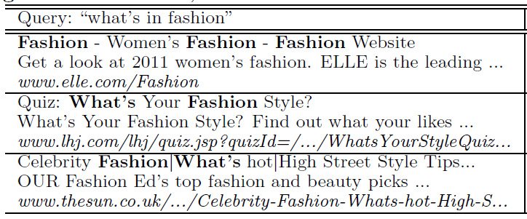
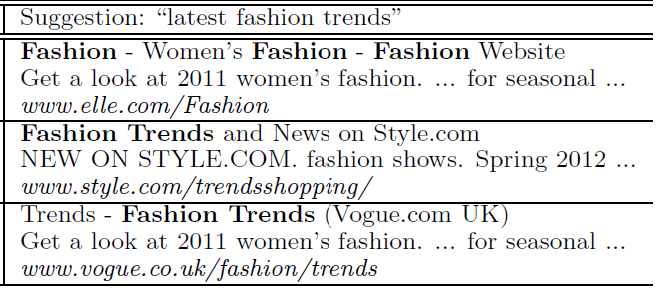
Intuition of Usefulness
One example of a difficult query, a better suggestion, and their top three search results returned by Google in November 4, 2011.
Notes:
Firstly, let’s construct an intuition of USEFULNESS, a useful query should be efficient.

Slide 16
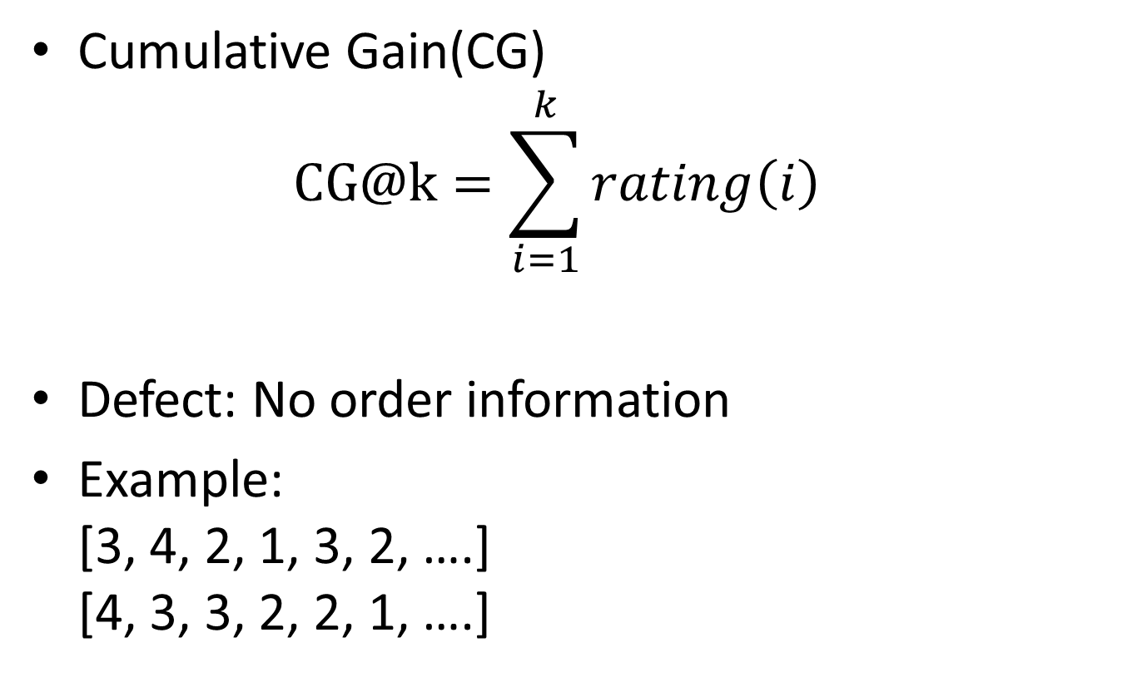
Measurement of Usefulness (1)
Cumulative Gain(CG) $CG@k=\sum_{i=1}^{k}{rating\left(i\right)}$
Defect: No order information
Example: [3, 4, 2, 1, 3, 2, ….] [4, 3, 3, 2, 2, 1, ….]
Notes:
@k means only take the top K results into consideration.
Rating(i) means the score at ith location
It is obvious that the defect of this measurement is that it cannot represents order information.
Here is an example. Not hard to see that the second one is better than the first one, but they are the same under this measurement.
Next, we will do some refinement to this measurement.

Slide 17
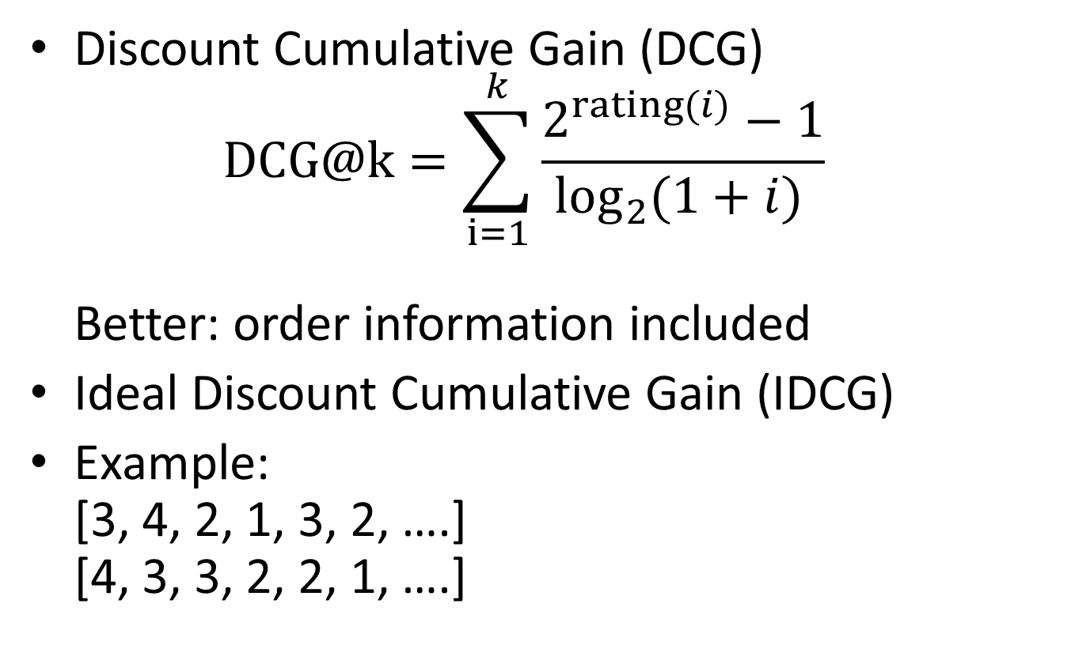
Measurement of Usefulness (2)
Discount Cumulative Gain (DCG) $DCG@k=\sum_{i=1}^{k}{\frac{2^{rating(i)}−1}{\log_{2}{(1+i)}⁡}}$ Better: order information included
Ideal Discount Cumulative Gain (IDCG)
Example: [3, 4, 2, 1, 3, 2, ….] [4, 3, 3, 2, 2, 1, ….]
Notes:
If we add a denominator to each term of the sum, then lower-ranked items will have a greater discount than the higher-ranked items. Thus, the order information is included into the measurement.
BTW, the Ideal DCG is the DCG value of the best ranked list.
Here is the same example, the DCG value of the second list is IDCG.

Slide 18
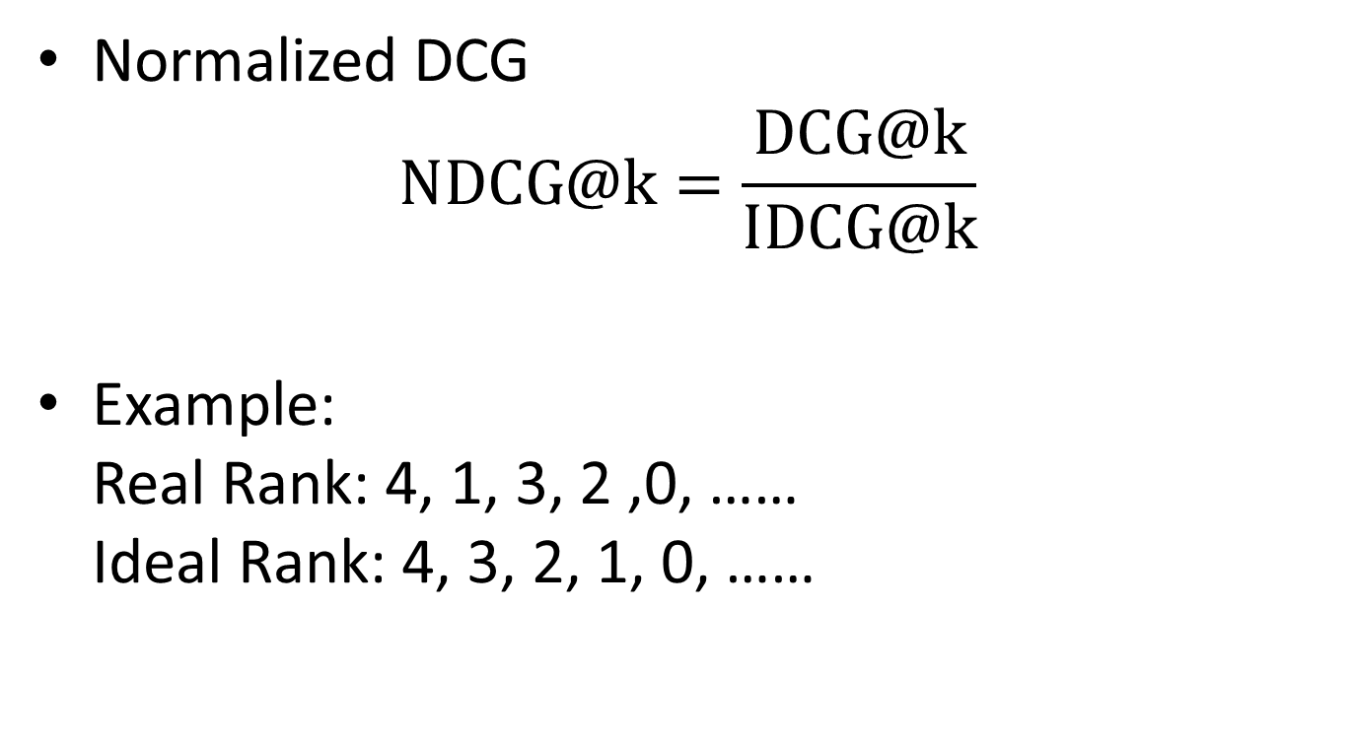
Measurement of Usefulness (3)
Normalized DCG $NDCG@k=\frac{DCG@k}{IDCG@k}$
Example: Real Rank: 4, 1, 3, 2 ,0, …… Ideal Rank: 4, 3, 2, 1, 0, ……
Notes:
After the preliminary definitions, here comes the final measurement of usefulness. The Normalized DCG. It is the DCG divided by IDCG. It should be very easy to be understood.

Slide 19
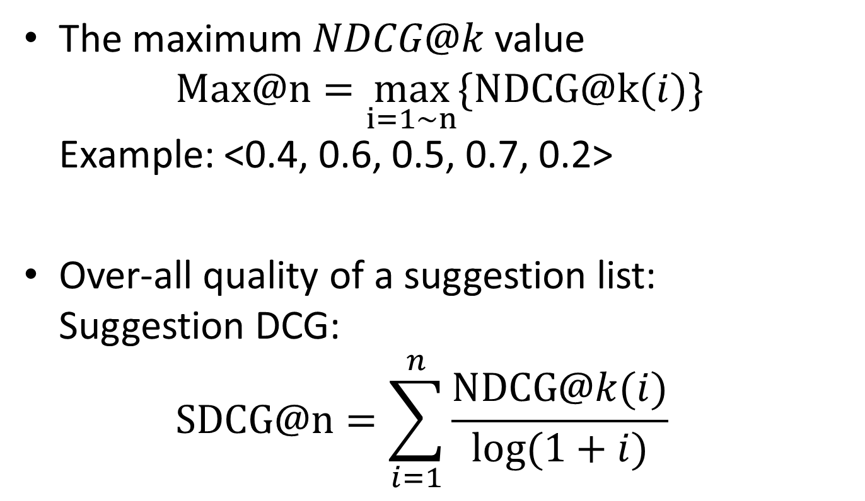
Evaluating a Suggestion List
The maximum $NDCG@k$value $Max@n=\max_{i=1\sim n}{\{NDCG@k(i)\}}$ Example: <0.4, 0.6, 0.5, 0.7, 0.2>
Over-all quality of a suggestion list: Suggestion DCG: $SDCG@n=\sum_{i=1}^{n}{\frac{NDCG@k(i)}{\log{(1+i)}}}$
Notes:
As for how to evaluating a suggestion list, we can use this strategy. Max@n means the max NDCG@k value among the first N suggestions.
Also we can measure the overall quality of a suggestion list by applying Suggestion DCG like this.
Any Questions so far?

Slide 20
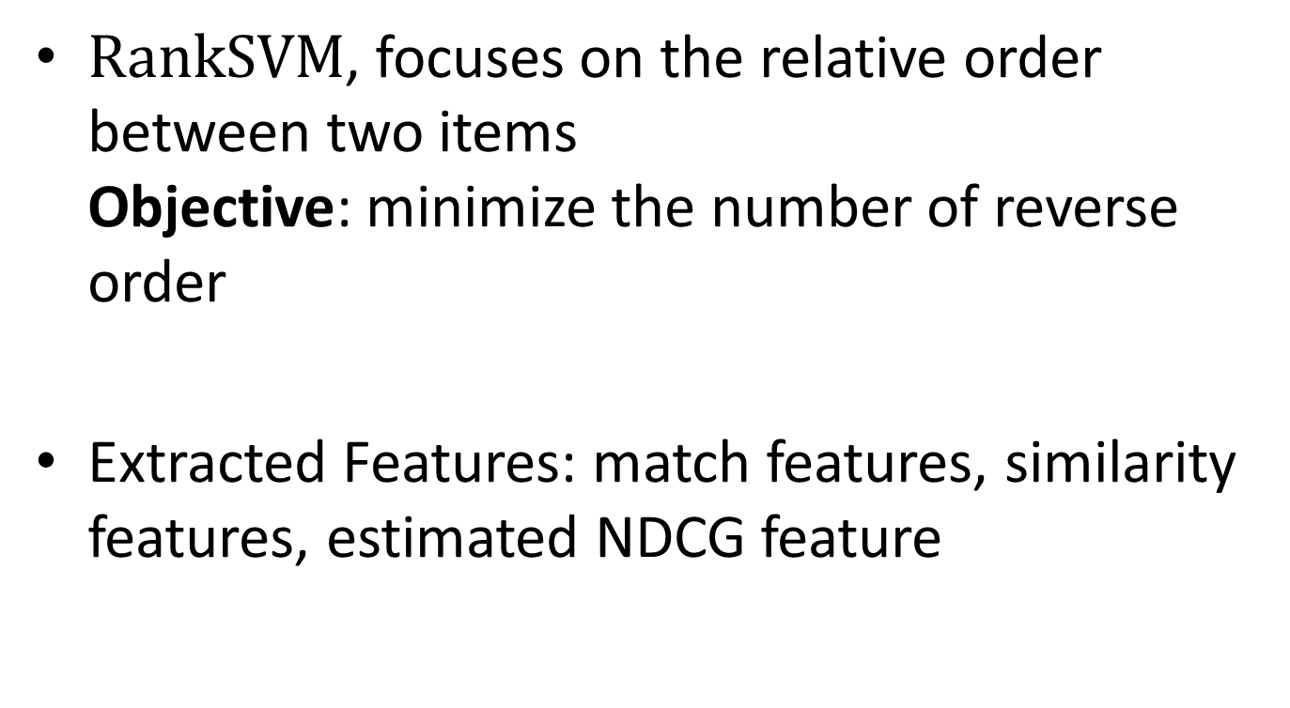
Learning to Rank Suggestions
$RankSVM$, focuses on the relative order between two items Objective: minimize the number of reverse order
Extracted Features: match features, similarity features, estimated NDCG feature
Notes:
As for the ranking strategy in this paper, it applies a machine learning based ranking method called RankSVM. I’m planning to expend all the details about this. In short, it is a method mainly focusing on the relative order between two items and trying to minimize the number of reverse order.
Besides the NDCGs, to apply SVM, the author also extracts other features like matching features, similarity features.
Such is how to suggestion USEFUL queries.
Next will come how to adapt to difficult queries.

Slide 21
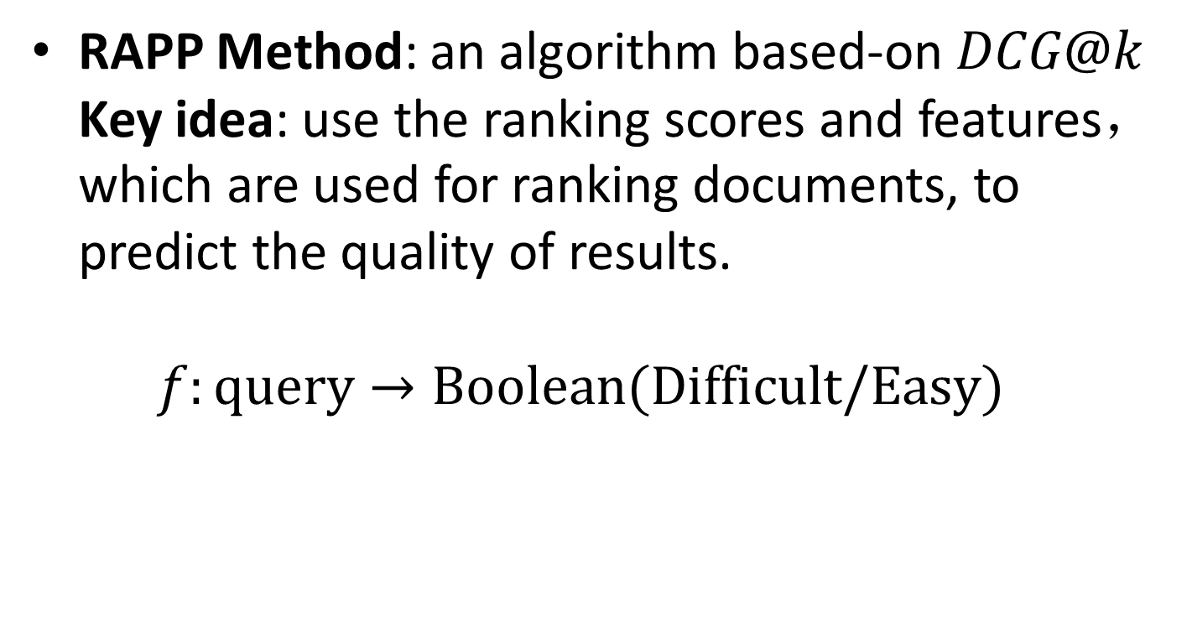
Adapt to Difficult Queries
RAPP Method: an algorithm based-on $DCG@k$ Key idea: use the ranking scores and features， which are used for ranking documents, to predict the quality of results. $f:query→Boolean(Difficult/Easy)$
Notes:
[RAPP is short for Rank-time Performance Prediction, Machine-learning based]
This method also uses DCG@k & NDCG@k value.

Slide 22
Summary
Query Suggestion: hot & useful
Paper I: Combine Syntactic & Semantic Info.
Paper II: Include Concept of “Usefulness” and Target on DIFFICULT queries
Trends: Subdivision & Machine-Learning Based
Notes:
Here finally comes the Summary:
First, Query Suggestion is a hot & useful topic. I say it hot because there exists a certain section called “Query Suggestion” in SIGIR since last year.
And, the main contribution of Paper I is that it combine the syntactic meaning & semantic meaning to help suggust.
As for Paper II, its main contribution is that it shows a way to measure usefulness and firstly propose an adaptive strategy, which only targets on one certain aspect of queries.
So, from the above, we can see something about the trends of this problem. Firstly, the problem is going into many subdivisions. I think this is mainly because of its industrial background and industrial problems are always very complicated. Secondly, they are always machine-learning based, which is probably because of the complexity of this problem, I think.

Slide 23
Thanks!
Q & A

